Slide 1
Finding the Shortest Path in a Mesh
Why We Use Dijkstra’s Algorithm

Slide 2
The Problem
• We need shortest water-paths from tide gauges across a massive mesh (~3.5M nodes).
• Old method: rescanned every edge repeatedly, so it’s very slow.
• We need something faster and guaranteed correct.

Slide 3
Real-World example
Imagine delivering mail in a city:
• Intersections = nodes
• Streets = edges with lengths
• Post Office = gauge
Old way: wander streets, repeat checks.
Better way: expand outward like Google Maps.
Post Office
House A
House B
House C

Slide 4
What Dijkstra Does:
Think of it like delivering mail. If I had a giant list of all the houses, and every time I wanted to deliver the next letter I had to scan the entire list for the closest house, that would take forever. That’s like the old method.
Dijkstra with a heap is smarter. It’s like keeping the houses in a special to-do bucket where the closest house always pops out automatically. That way, I don’t waste time looking through everyone again.
That’s why, instead of hours or days, we can solve our 3.5-million-node mesh in seconds.

Slide 5
Pacific
• Intersections = mesh nodes
• Streets = wet edges between nodes
• Post Office = tide gauge
• Destination = every node in Pacific mesh
Node 1
Node 2
Gauge
Node 3
Node 4

Slide 6
What Dijkstra Does:
Think of dropping a small rock in a calm pond, ripples spread outward evenly in all directions. Dijkstra does something very similar, but instead of ripples of water, it’s ripples of distance.
Starting at the tide gauge, the algorithm expands outward, node by node, just like a wavefront. Every time it reaches a new node, it records the shortest distance found so far.
After that, it immediately passes the information along to that node’s neighbors. It’s like saying: ‘If I can get here in 10 km, then you, my neighbor, can be reached in 10 km plus the edge between us.’ If that new path is better than what the neighbor thought before, we update it.
This cycle keeps repeating. Each settled node pushes the ripple outward until every node in the ocean mesh has its exact shortest distance from the tide gauge.
So just like waves spreading across the sea, Dijkstra spreads distance information across the mesh, but unlike real water, it never gets distorted. It always guarantees the mathematically true shortest path.

Slide 7
Old Method (brute-force rescanning)
Imagine instead of ripples spreading outward, you had to re-scan the entire ocean again and again.
Every time you checked a new node, you’d go back through every edge to see if maybe there was a shorter path hiding somewhere.
It’s like a mail carrier who, after delivering one letter, starts from the post office all over again, re-checking every street, every house, every time.

Slide 8
Summary
Instead of repeating the whole scan, Dijkstra keeps track of progress.
Once a node’s shortest distance is locked in, it never needs to be reconsidered.
That’s why Dijkstra only looks at each edge once, no endless rescan.
In practice: hours or days shrink down to seconds for your ocean mesh.
Dijkstra is safer because it never guesses or overlooks a shorter route, every step it takes is locked in as correct. Once a distance is set, it’s guaranteed to be the best possible.

Slide 9
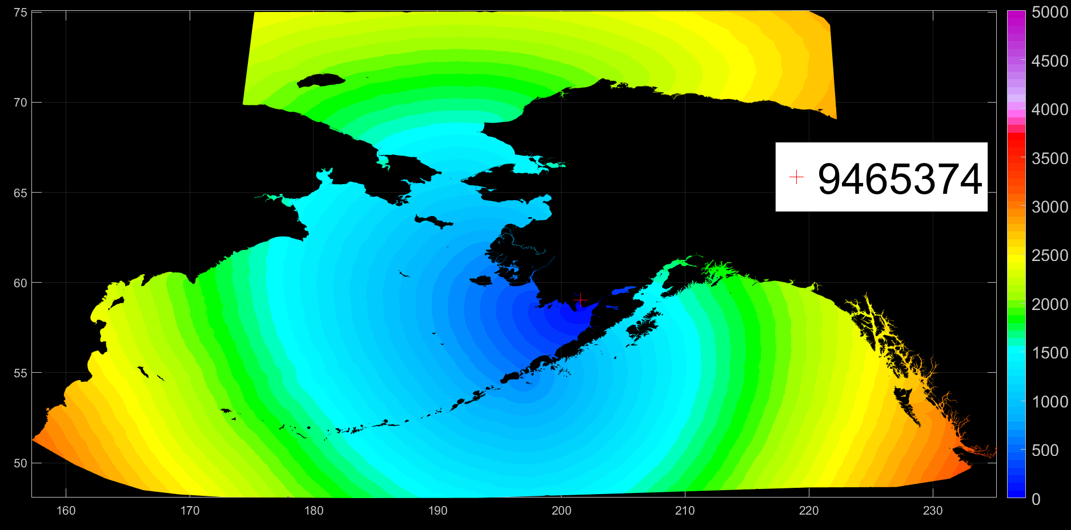
Old method

Slide 10
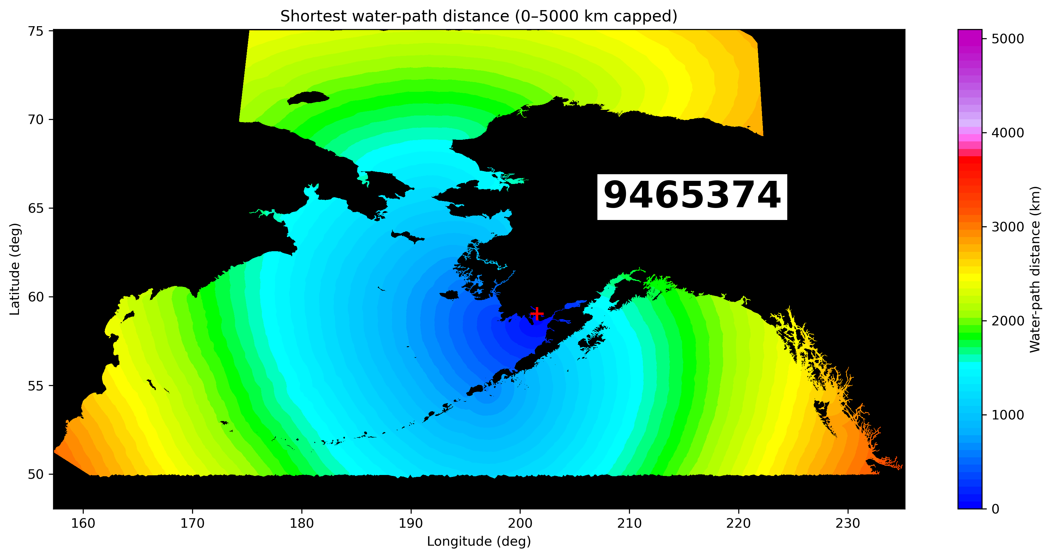
New method
2025-09-02 13:19:12.825905 — starting single-gauge test… Gauge 1: station_id=9499176, node0=2682424 Graph built: 13,934,444 undirected edges. (elapsed 9.1s) Wrote station9499176.nc min/median/max dist (km): 0.000 / 3145.631 / 5443.074 Done. Elapsed: 21.6s

Slide 11
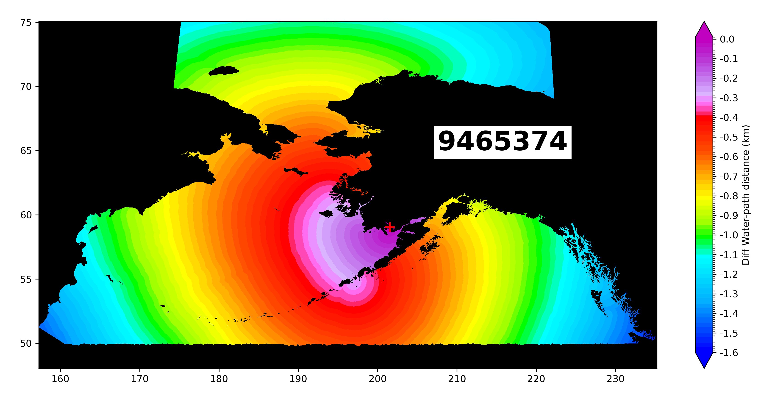
New method-Old method

Slide 12
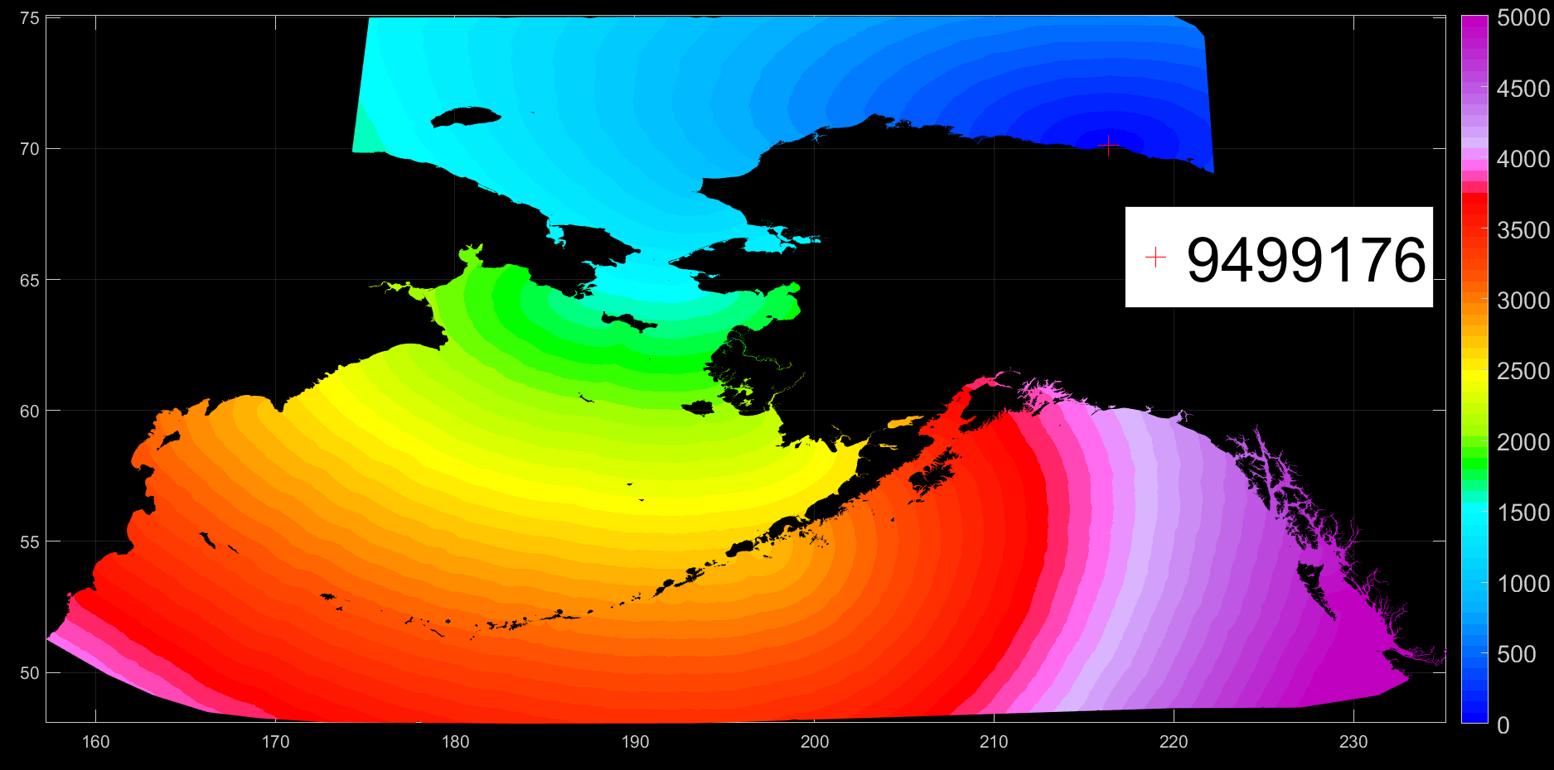
Old method

Slide 13
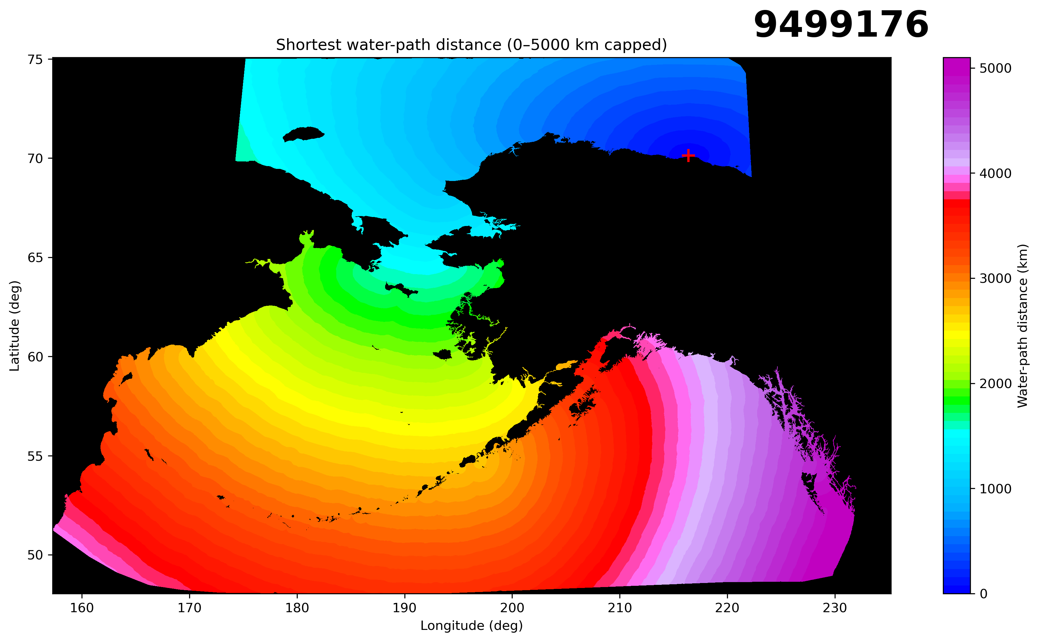
New method

Slide 14
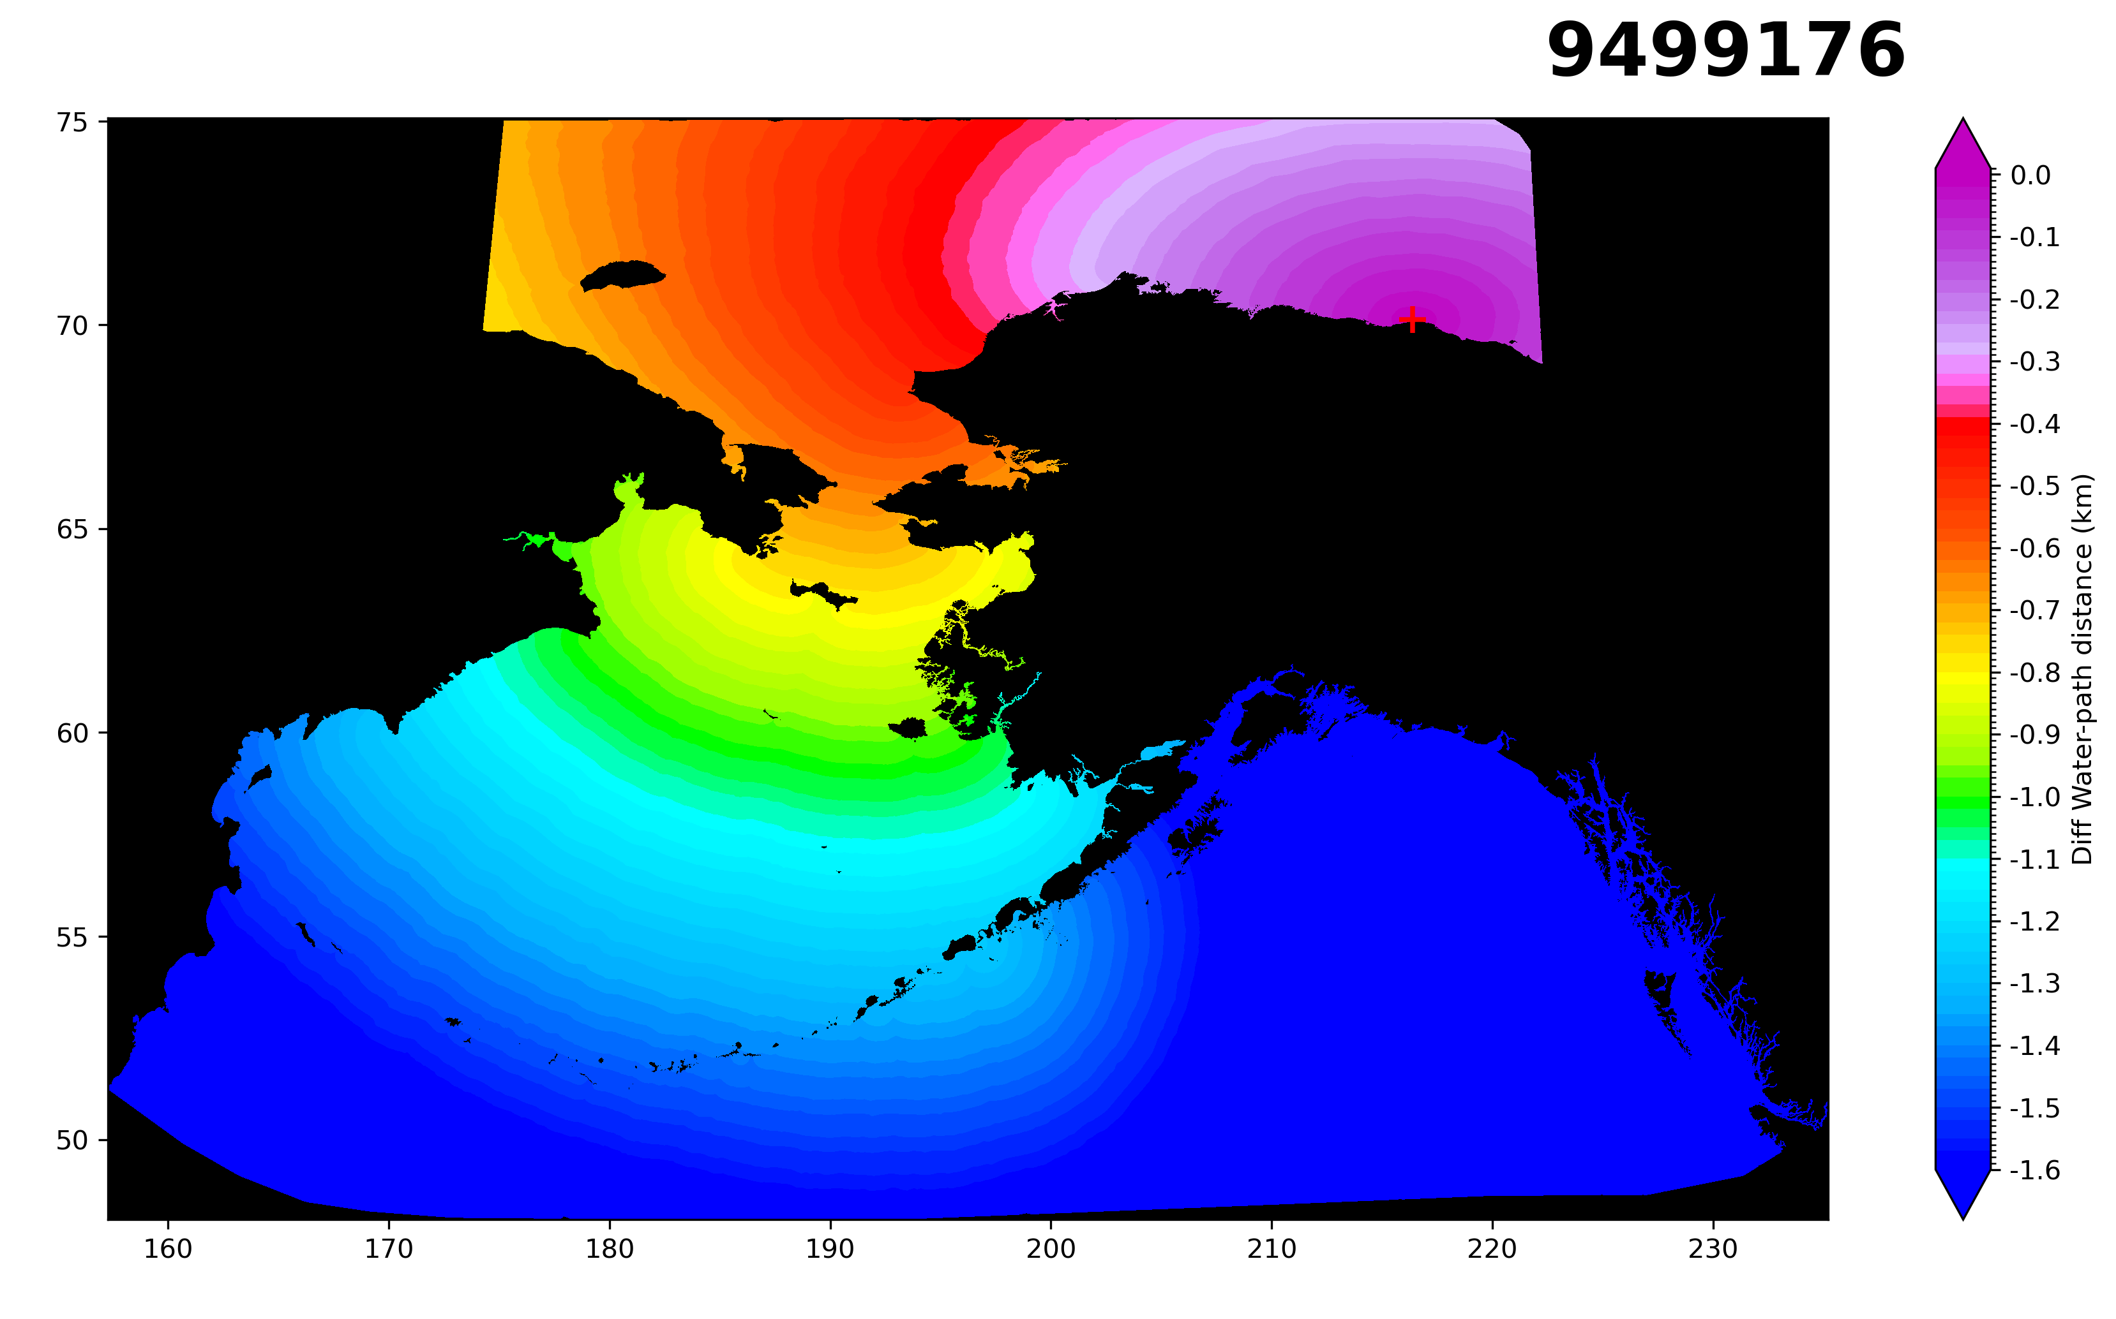
New method-Old method

